Slide 1
Artificial Intelligence
CSE411(Theory)
Md. Monarul Islam Mithu
Lecturer, Daffodil International University, CSE
B.Sc. In CSE, KUET
M.Sc. In CSE(Ongoing), BUET

Slide 2
Syllabus
Introduction to Artificial Intelligence (Chapter1)
AI searching algorithm. (Chapter 2) [Advanced Searching]
Intelligent agent and it’s behaviour. (Chapter 3)
Knowledge Base Representation (Chapter 4)
Fuzzy Logic and Fuzzy system. (Chapter 5)
Artificial Neural Network(ANN) (Chapter 6)

Slide 3
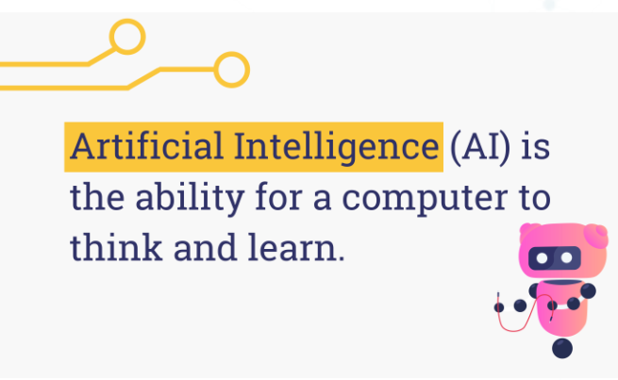
Artificial Intelligence

Slide 4
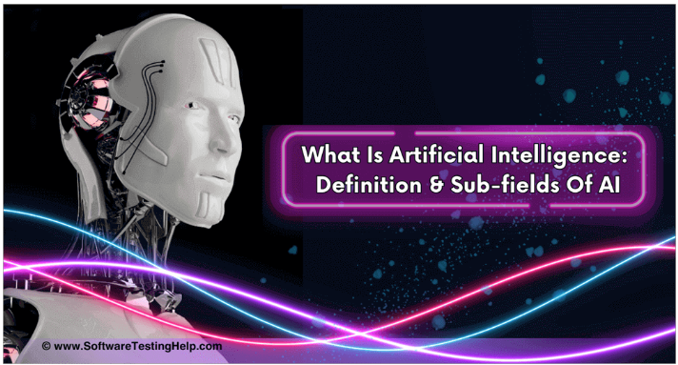
Artificial Intelligence

Slide 5
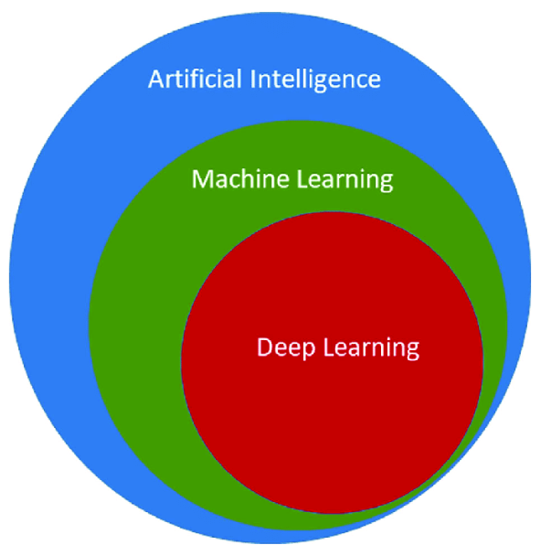
Artificial Intelligence

Slide 6
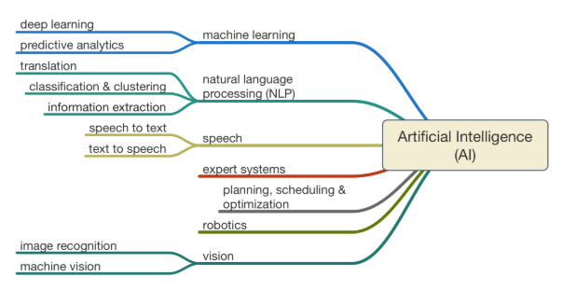
Artificial Intelligence

Slide 7
How can you ensure that a machine reach at AI ?
The Turing Test is a concept introduced by Alan Turing, a British mathematician and computer scientist, in his 1950 paper "Computing Machinery and Intelligence".
The test aims to evaluate a machine's ability to exhibit intelligent behavior.

Slide 8
Turing Test
The test involves three participants:
A human interrogator: A person who asks questions.
A human respondent: A person answering the questions.
A machine: A computer program designed to simulate human responses.

Slide 9
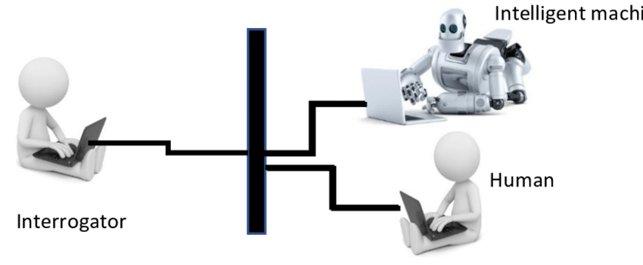
Turing Test

Slide 10
Turing Test
The interrogator asks questions to both the human and the machine.
The goal of the interrogator is to determine which participant is the machine.
The machine aims to mimic human responses. It must convince the interrogator it is human. If the interrogator can't tell them apart, the machine passes the test.

Slide 11
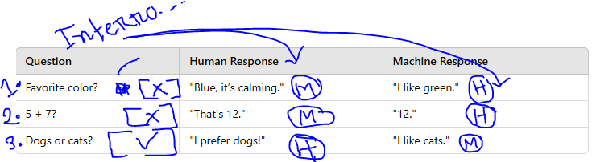
Turing Test

Slide 12
Thank You

